Slide 1

VIRTUALIZATION AND CLOUD COMPUTING
Subject Code: CSE423
Presented By
Mr. ENJULA UCHOI
Assistant Professor
(Artificial Intelligent –II)
ID Code: 29634

Slide 2
CONTENT
Unit I
Virtualization Techniques
Overview of Distributed computing
Unit II
Introduction to cloud computing
Migrating into a cloud
Unit III
Understanding Cloud Architecture
Unit IV
Cloud computing technologies and applications
Cloud Economics

Slide 3
CONTENTS CONTD..
Unit V
Cloud Security
Cloud database
Unit VI
Container Technology
Cloud Platforms in Industry
Other aspects of cloud

Slide 4
EVALUATION CRITERIA
Class Participation 05
Includes---- Punctuality, Active participation/quick response in the class
CA (Two best out of Three CA) 20
CA consists of two MCQ based test and 1 term paper
CA1 ---MCQ Based
CA2---MCQ Based

Slide 5
X86 VIRTUALIZATION
X86 virtualization is a technology that allows multiple operating systems to run on the same physical hardware. It uses hardware-assisted virtualization on x86/x86-64 CPUs, which enables the computer to run multiple isolated guest operating systems simultaneously. This technology provides greater flexibility and cost savings by allowing organizations to consolidate their server resources into fewer physical machines. Additionally, it can help improve security by isolating applications from each other and providing better control over access rights.

Slide 6
WHAT IS VIRTUALIZATION?
With the help of Virtualization, multiple operating systems and applications can run on same machine and its same hardware at the same time, increasing the utilization and flexibility of hardware.
Virtualization allows to share a single physical instance of a resource or an application among multiple customers and organizations at one time. The term virtualization is often synonymous with hardware virtualization, which plays a fundamental role in efficiently delivering Infrastructure-as-a-Service (IaaS) solutions for cloud computing. Moreover, virtualization technologies provide a virtual environment for not only executing applications but also for storage, memory, and networking.

Slide 7
BENEFITS OF VIRTUALIZATION 1. More flexible and efficient allocation of resources. 2. Enhance development productivity. 3. It lowers the cost of IT infrastructure. 4. Remote access and rapid scalability. 5. High availability and disaster recovery. 6. Pay peruse of the IT infrastructure on demand. 7. Enables running multiple operating
Types of Virtualization:
1.Application Virtualization. 2.Network Virtualization. 3.Desktop Virtualization. 4.Storage Virtualization. 5.Server Virtualization. 6.Data virtualization.

Slide 8
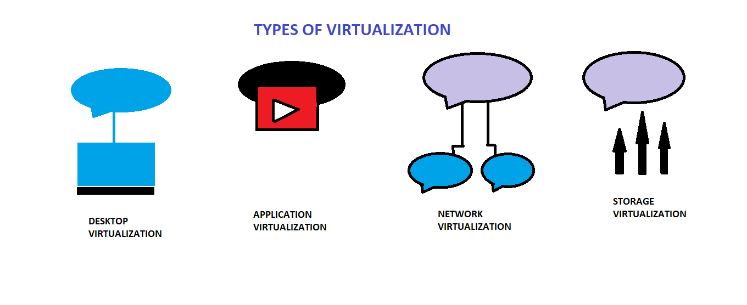

Slide 9
TYPES OF VIRTUALIZATION
Application Virtualization: Application virtualization helps a user to have remote access of an application from a server. The server stores all personal information and other characteristics of the application but can still run on a local workstation through the internet
2. Network Virtualization: The ability to run multiple virtual networks with each has a separate control and data plan. It co-exists together on top of one physical network. It can be managed by individual parties that potentially confidential to each other. Network virtualization provides a facility to create and provision virtual networks—logical switches, routers, firewalls, load balancer, Virtual Private Network (VPN), and workload security within days or even in weeks.

Slide 10
TYPES OF VIRTUALIZATION cont.
3. Desktop Virtualization: Desktop virtualization allows the users’ OS to be remotely stored on a server in the data centre. It allows the user to access their desktop virtually, from any location by a different machine.
4. Storage Virtualization: Storage virtualization is an array of servers that are managed by a virtual storage system. The servers aren’t aware of exactly where their data is stored, and instead function more like worker bees in a hive. It makes managing storage from multiple sources to be managed and utilized as a single repository. storage virtualization software maintains smooth operations, consistent performance and a continuous suite of advanced functions despite changes, break down and differences in the underlying equipment.

Slide 11
TYPES OF VIRTUALIZATION cont.
5. Server Virtualization: This is a kind of virtualization in which masking of server resources takes place. Here, the central-server(physical server) is divided into multiple different virtual servers by changing the identity number, processors. So, each system can operate its own operating systems in isolate manner. Where each sub-server knows the identity of the central server
6. Data virtualization: This is the kind of virtualization in which the data is collected from various sources and managed that at a single place without knowing more about the technical information like how data is collected, stored & formatted then arranged that data logically so that its virtual view can be accessed by its interested people and stakeholders, and users through the various cloud services remotely. Many big giant companies are providing their services like Oracle, IBM, At scale, Cdata, etc.

Slide 12
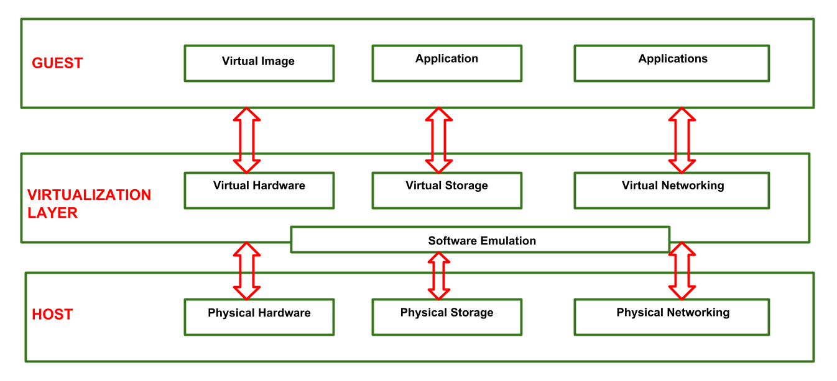
VIRTUALIZATION REFERENCE MODEL

Slide 13
Three major Components falls under this category in a virtualized environment:
1. GUEST: The guest represents the system component that interacts with the virtualization layer rather than with the host, as would normally happen. Guests usually consist of one or more virtual disk files, and a VM definition file. Virtual Machines are centrally managed by a host application that sees and manages each virtual machine as a different application.
2. HOST: The host represents the original environment where the guest is supposed to be managed. Each guest runs on the host using shared resources donated to it by the host. The operating system, works as the host and manages the physical resource management, and the device support.
3. VIRTUALIZATION LAYER: The virtualization layer is responsible for recreating the same or a different environment where the guest will operate. It is an additional abstraction layer between a network and storage hardware, computing, and the application running on it. Usually it helps to run a single operating system per machine which can be very inflexible compared to the usage of virtualization.

Slide 14
VIRTUAL LAN (VLAN)
Virtual LAN (VLAN) is a concept in which we can divide the devices logically on layer 2 (data link layer). Generally, layer 3 devices divide broadcast domain but broadcast domain can be divided by switches using the concept of VLAN.
VLAN ranges –
VLAN 0, 4095: These are reserved VLAN which cannot be seen or used.
VLAN 1: It is the default VLAN of switches. By default, all switch ports are in VLAN. This VLAN can’t be deleted or edit but can be used.
VLAN 2-1001: This is a normal VLAN range. We can create, edit and delete these VLAN.
VLAN 1002-1005: These are CISCO defaults for fddi and token rings. These VLAN can’t be deleted.
Vlan 1006-4094: This is the extended range of Vlan.

Slide 15
TYPES OF CONNECTIONS IN VLAN
Types of connections in VLAN –
There are three ways to connect devices on a VLAN, the type of connections are based on the connected devices i.e. whether they are VLAN-aware(A device that understands VLAN formats and VLAN membership) or VLAN-unaware(A device that doesn’t understand VLAN format and VLAN membership).
Trunk Link – All connected devices to a trunk link must be VLAN-aware. All frames on this should have a special header attached to it called tagged frames.
Access link – It connects VLAN-unaware devices to a VLAN-aware bridge. All frames on the access link must be untagged.
Hybrid link – It is a combination of the Trunk link and Access link. Here both VLAN-unaware and VLAN-aware devices are attached and it can have both tagged and untagged frames.

Slide 16
ADVANTAGES
Performance – The network traffic is full of broadcast and multicast. VLAN reduces the need to send such traffic to unnecessary destinations. e.g.-If the traffic is intended for 2 users but as 10 devices are present in the same broadcast domain, therefore, all will receive the traffic i.e. wastage of bandwidth but if we make VLANs, then the broadcast or multicast packet will go to the intended users only.
Formation of virtual groups – As there are different departments in every organization namely sales, finance etc., VLANs can be very useful in order to group the devices logically according to their departments.
Security – In the same network, sensitive data can be broadcast which can be accessed by the outsider but by creating VLAN, we can control broadcast domains, set up firewalls, restrict access. Also, VLANs can be used to inform the network manager of an intrusion. Hence, VLANs greatly enhance network security.
Flexibility – VLAN provide flexibility to add, remove the number of host we want.
Cost reduction – VLANs can be used to create broadcast domains which eliminate the need for expensive routers. By using Vlan, the number of small size broadcast domain can be increased which are easy to handle as compared to a bigger broadcast domain.

Slide 17
DISADVANTAGES
Disadvantages of VLAN
Complexity: VLANs can be complex to configure and manage, particularly in large or dynamic cloud computing environments.
Limited scalability: VLANs are limited by the number of available VLAN IDs, which can be a constraint in larger cloud computing environments.
Limited security: VLANs do not provide complete security and can be compromised by malicious actors who are able to gain access to the network.
Limited interoperability: VLANs may not be fully compatible with all types of network devices and protocols, which can limit their usefulness in cloud computing environments.
Limited mobility: VLANs may not support the movement of devices or users between different network segments, which can limit their usefulness in mobile or remote cloud computing environments.
Cost: Implementing and maintaining VLANs can be costly, especially if specialized hardware or software is required.
Limited visibility: VLANs can make it more difficult to monitor and troubleshoot network issues, as traffic is isolated in different segments.

Slide 18
VIRTUAL STORAGE AREA NETWORK (VSAN)
A virtual storage area network (VSAN) is a logical partition in a physical storage area network (SAN). VSANs enable traffic to be isolated within specific portions of a storage area network, so if a problem occurs in one logical partition, it can be handled with a minimum of disruption to the rest of the network.
The benefits of VSAN
Performance - since the local server can access data at full speed and low latency.
Lower infrastructure cost -since there are no networked storage appliances.
High scalability- simply put, add more servers and get more storage.
No boot storms - since OS/app stack images are stored locally
Unified management – no storage silo versus server silo demarcation problems.

Slide 19
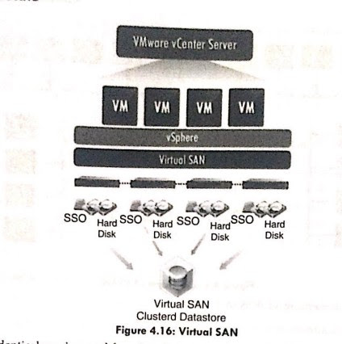
A VSAN provides identical services and functionality as a traditional SAN, but because it is virtualized, it enables the addition and relocation of subscribers without changing the actual topology of the network. It also has a variable storage capacity that may be raised or lowered over time. VSANS enable traffic to be isolated inside specified areas of a storage area network, allowing a problem in one logical partition to be handled with little disturbance to the rest of the network. The usage of numerous, separated VSANs can also make it easier to set up and scale out a storage system. Subscribers can be added or moved without altering the physical layout.

Slide 20
RELEVANT RESOURCES
https://www.techtarget.com/searchcloudcomputing/definition/cloud-computing
https://www.ibm.com/topics/cloud-computing
https://www.geeksforgeeks.org/cloud-computing/
Cloud Computing Bible(Textbook), Barrie Sosinsky, 1st edition Wiley India Pvt Ltd.
Cloud computing: Fundamentals, Industry Approach and Trends (Reference book), Rishabh Sharma, 1st edition Wiley India Pvt Ltd
Mastering Cloud Computing (Reference book), Raj kumar Buyya, Chritian Vecchiola, S. Thamarai Selvi, 3rd Edition Tata Mcgraw hill.

Slide 21
THANK YOU

